Slide 1
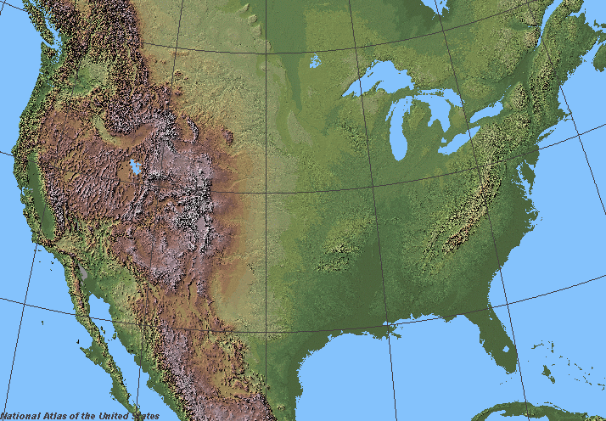
Geographic Factors on US Population Changes
Conner Sick

Slide 2

Question
Do any geographical factors contribute to population movement and growth in the US?

Slide 3
Geographic Variables
Average Temperature
Average Annual Precipitation
Elevation
Notes:
Data Sources: Census and World population Review data for Population Totals, US Geological Survey data for Elevations, National Oceanic and Atmospheric Administration data for temperatures and precipitation
County-level data

Slide 4
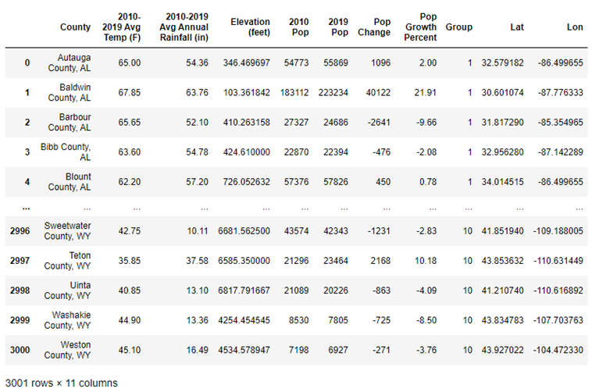
Data Cleanup
Notes:
Grouping by county data with state abbreviations, consolidating all elevation data and taking county averages,

Slide 5
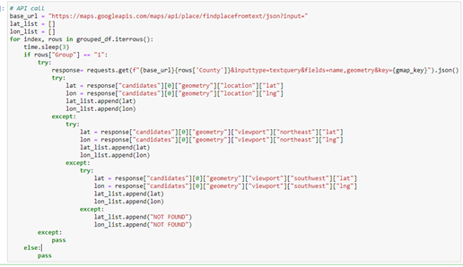
Data Cleanup
API Call

Slide 6
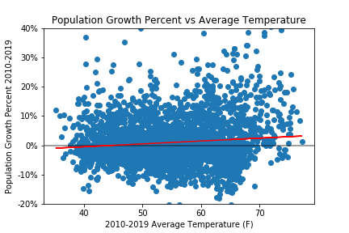
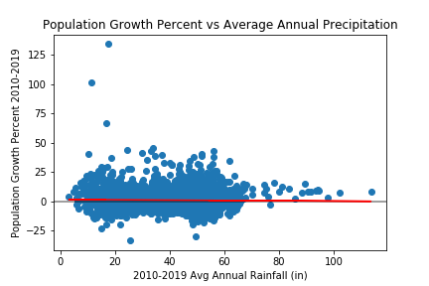
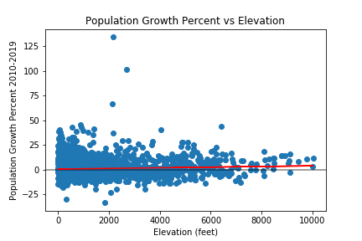
Data Visualization
P-Value: .000000423
P-Value: .2175
P-Value: .001938
No statistically significant correlation between population growth percentages and any of the chosen variables

Slide 7
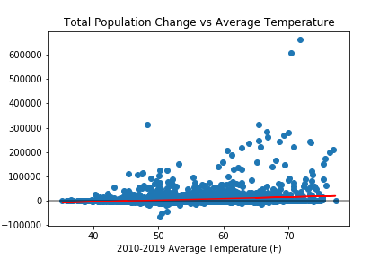
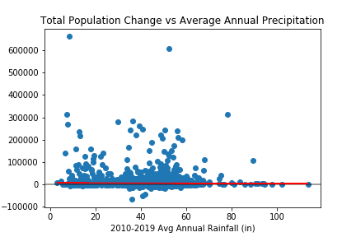
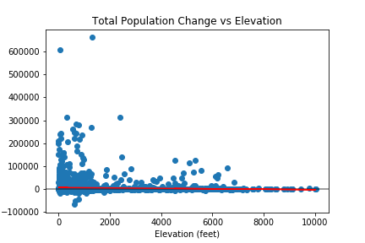
Data Visualization
P-Value: .00000…
P-Value: .4055
P-Value: .00754
No statistically significant correlation between total population change and any of the chosen variables

Slide 8
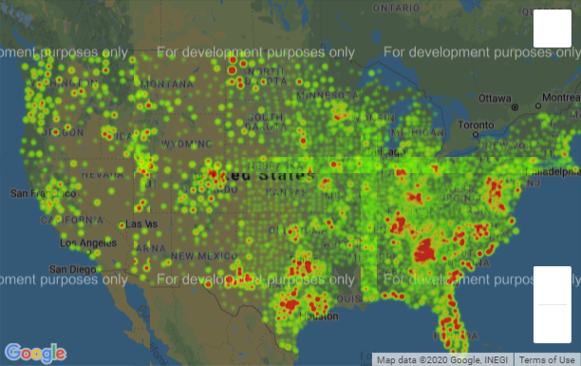
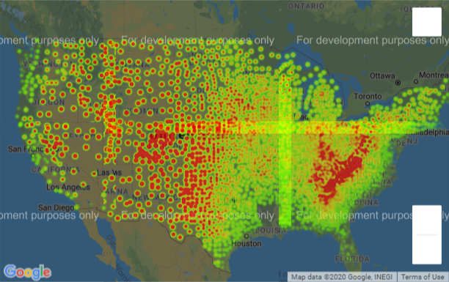
Maps
Population Growth Percent by County
Elevation by County

Slide 9
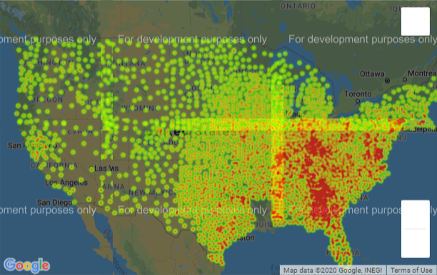
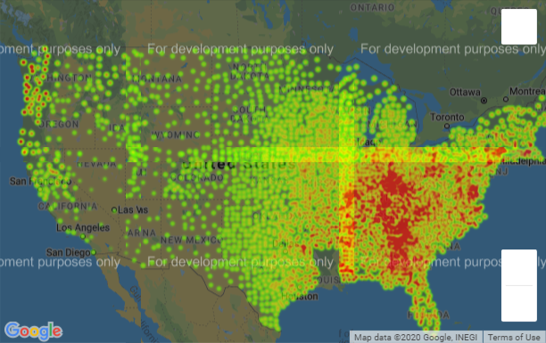
Maps
Average Temperature by County
Average Precipitation by County

Slide 10
Questions?

Slide 11
Data Sources
https://www.census.gov/data/datasets/time-series/demo/popest/2010s-counties-total.html
https://worldpopulationreview.com/us-counties/
https://www.usgs.gov/core-science-systems/ngp/board-on-geographic-names/download-gnis-data
NOAA National Centers for Environmental information, Climate at a Glance: County Mapping, published June 2020, retrieved on June 30, 2020 from https://www.ncdc.noaa.gov/cag/

